Slide 1
usedtown
UsedTown: Revolutionizing Second-Hand Markets with Secure, Eco-Friendly Transactions. Join Us in Transforming Clutter into Cash!

Slide 2
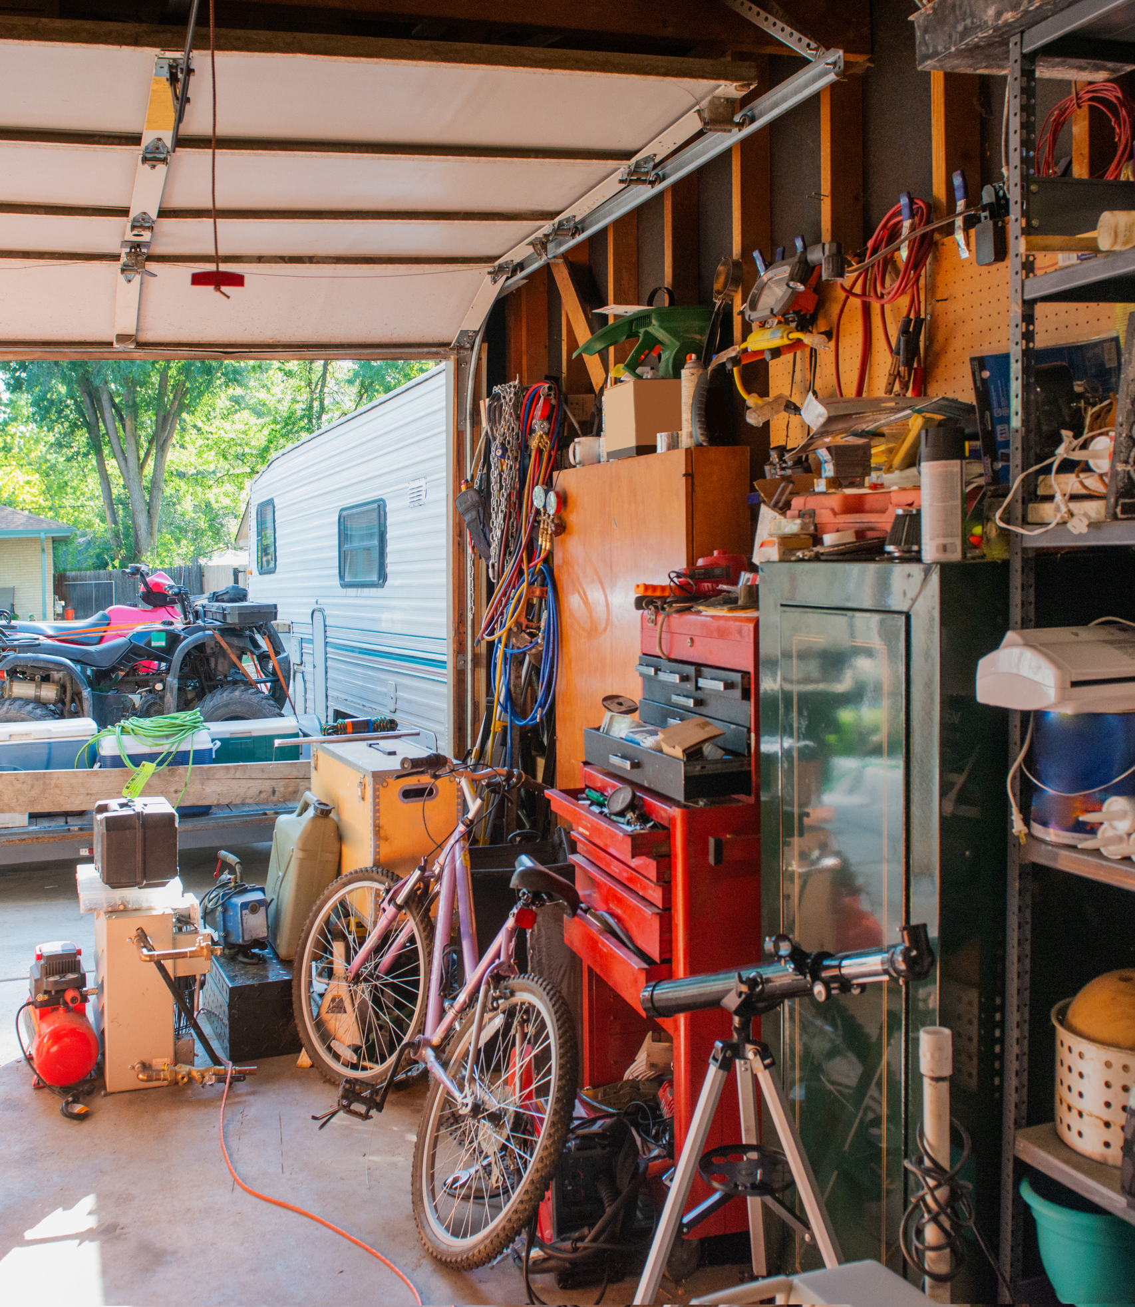
01
Introduction
Welcome to UsedTown: the secure, eco-friendly marketplace revolutionizing the second-hand industry. Discover how we turn clutter into cash with a seamless, sustainable platform designed for smart, responsible consumers.

Slide 3
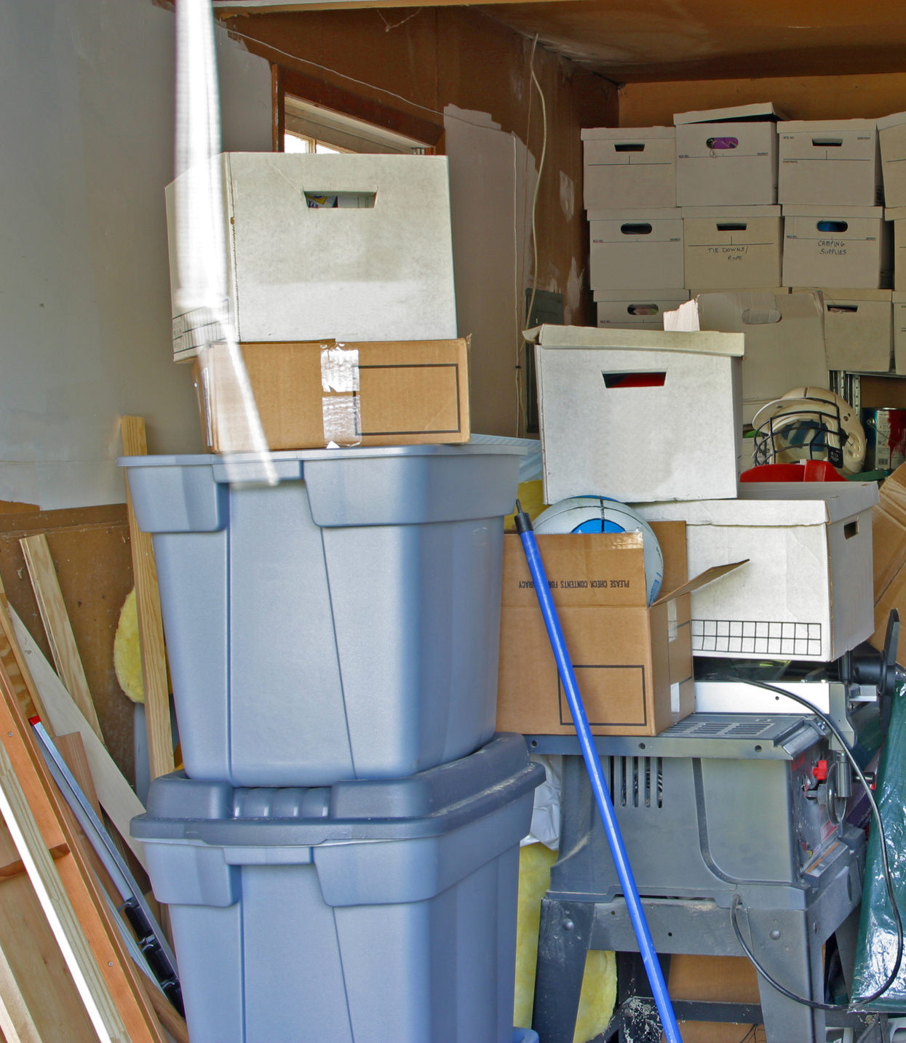
02
Problem
Millions of households are overwhelmed with unused items, contributing to environmental waste. Traditional marketplaces lack security and trust, leading to scams and inefficient recycling. Consumers need a reliable, eco-friendly solution for decluttering and recycling.

Slide 4
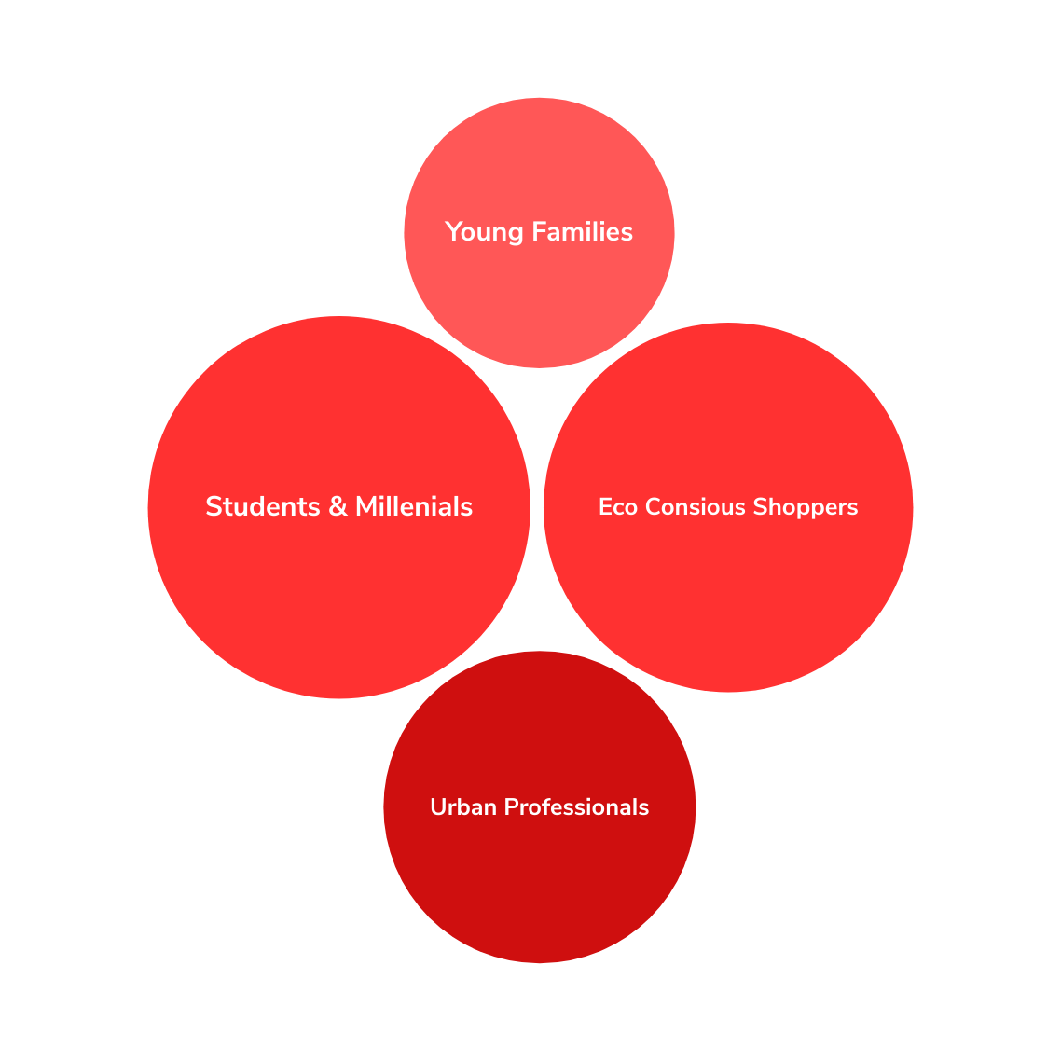
Target Market
UsedTown targets eco-conscious and tech-savvy consumers seeking sustainable solutions. Our primary audience includes:
03

Slide 5
Solution
04
UsedTown is transforming the second-hand market by providing a secure, eco-friendly, and easy-to-use platform. We empower users to turn unused items into cash, reduce environmental waste, and engage in safe, seamless transactions—all while contributing to a more sustainable and responsible marketplace.
Secure Marketplace
Eco-Friendly Approach
Easy-to-Use Platform
UsedTown provides a verified user system and secure payments powered by Stripe, ensuring safe transactions and protecting buyers and sellers from fraud.
By facilitating the resale of second-hand goods, UsedTown helps reduce waste and promotes sustainability, making eco-conscious living more accessible to everyone.
With intuitive features like promotions, automatic fulfillment with courier partners, and streamlined payments, UsedTown makes buying and selling seamless and efficient.

Slide 6
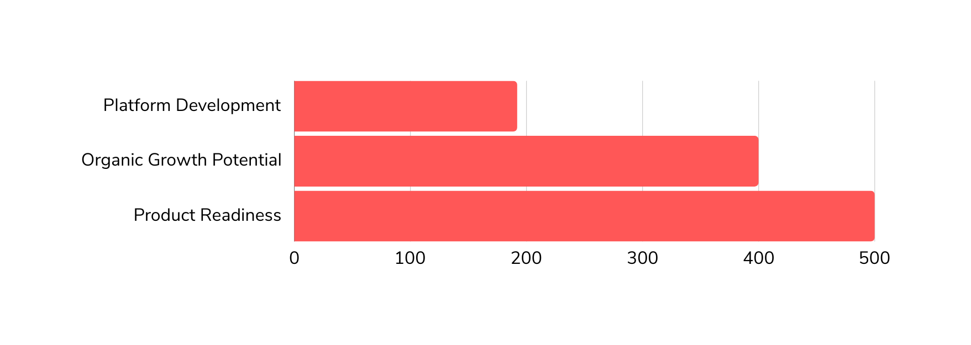
Traction
05
Despite no advertising efforts, UsedTown has successfully developed a fully functional platform and organically onboarded 192 users. Our early adopters validate the platform's potential, positioning us for significant growth as we begin scaling with marketing strategies.

Slide 7
06
Targeted Digital Advertising
Utilize precise digital ads on Google and social media to reach eco-conscious and urban professionals, maximizing user engagement and acquisition.
Strategic Partnerships
Form alliances with influencers and brands to enhance credibility and reach, driving user acquisition through trusted voices.
Marketing Strategy
Engaging Content Marketing
To quickly acquire users and boost brand awareness, UsedTown will use targeted digital ads, strategic partnerships, and engaging content. Our data-driven approach aims to efficiently reach 50,000 users.
Produce compelling content—blogs, videos, and social media posts—to highlight UsedTown's benefits, boost organic traffic, and build community engagement.

Slide 8
07
Market Competition
While Dubizzle operates as a classified ads site, UsedTown offers a full suite of e-commerce services, including secure payments, warehouse fulfillment, escrow-backed transactions, verified delivery, and courier integration, providing a comprehensive and trustworthy marketplace experience.

Slide 9
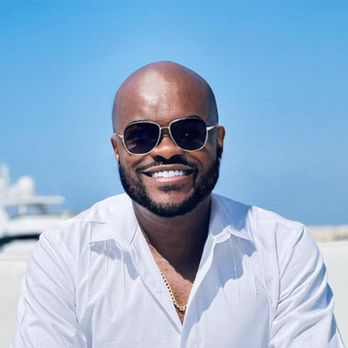
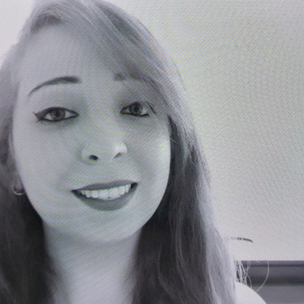
Our Team
08
Our team is a blend of industry experts and passionate innovators dedicated to revolutionizing the second-hand marketplace. With diverse backgrounds in technology, e-commerce, and sustainability, we bring the expertise and vision needed to drive UsedTown’s success.
Joseph Nwudu
Harry Gerrard
Ayat Najjar
MBBS/Developer
BSC/CEO
MSC/CFO

Slide 10
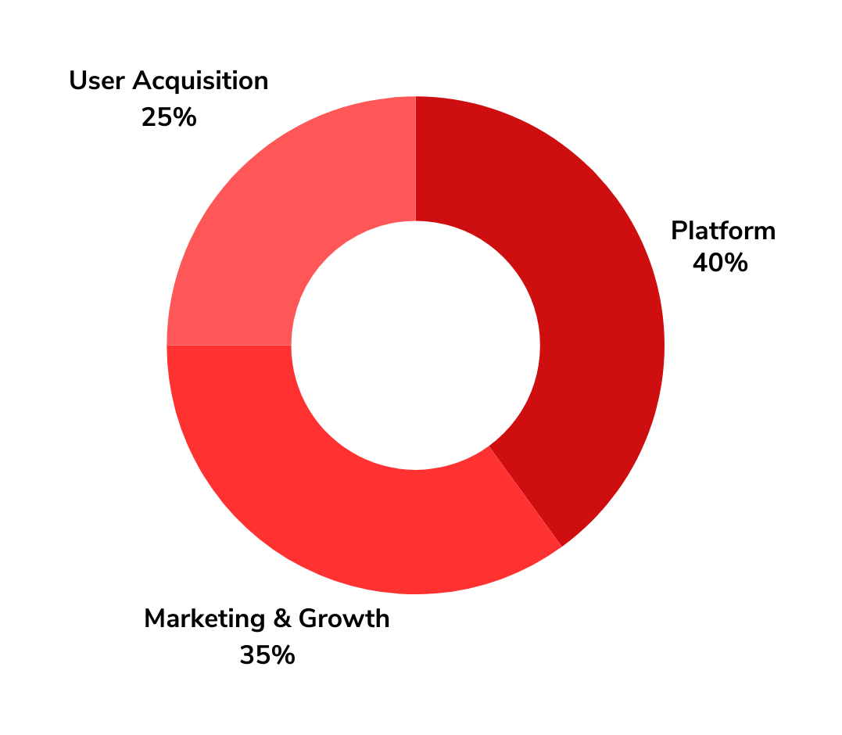
Investment and Funding
UsedTown seeks $500,000 in seed funding to scale operations, enhance marketing efforts, and reach our first 50,000 users. This investment will drive platform development, expand our user base, and establish a strong market presence.
09

Slide 11
Contact Us :
10
+971555223156
We’re excited to connect with potential investors, partners, and users. For inquiries about investment opportunities or to learn more about our platform, reach out to us through the channels below.
hello@usedtown.org
www.usedtown.com
651N Broad Street,
Suite 206, Middletown
19709 Delaware

Slide 12
Thank You

